Slide 1
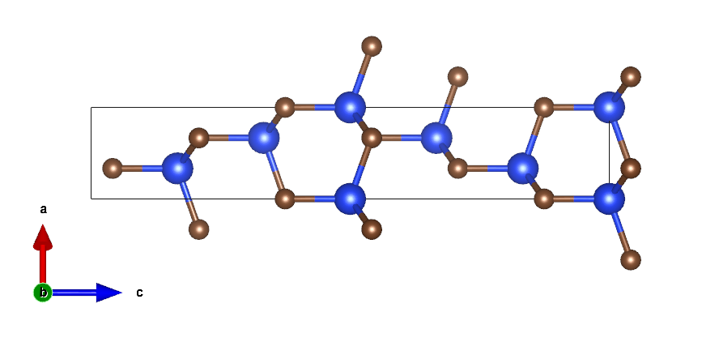
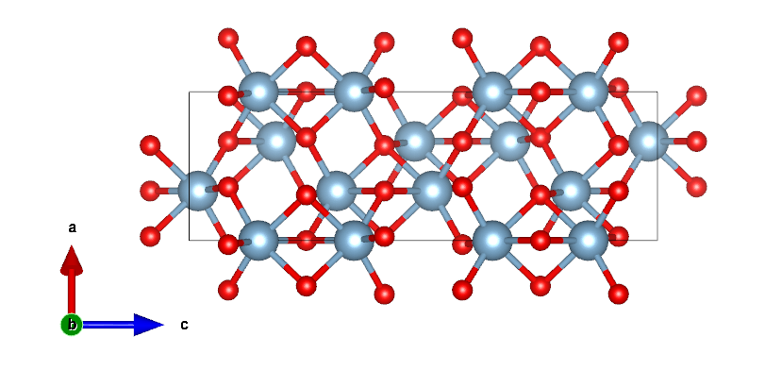
DFT calculation of KF on SiC and Al2O3
C
O
Al
Si
Trigonal, R3̅c
Trigonal, R3m

Slide 2
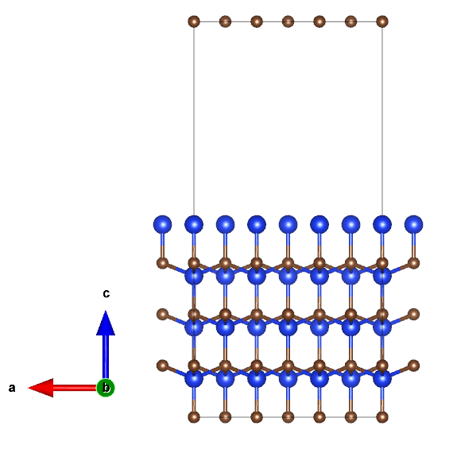
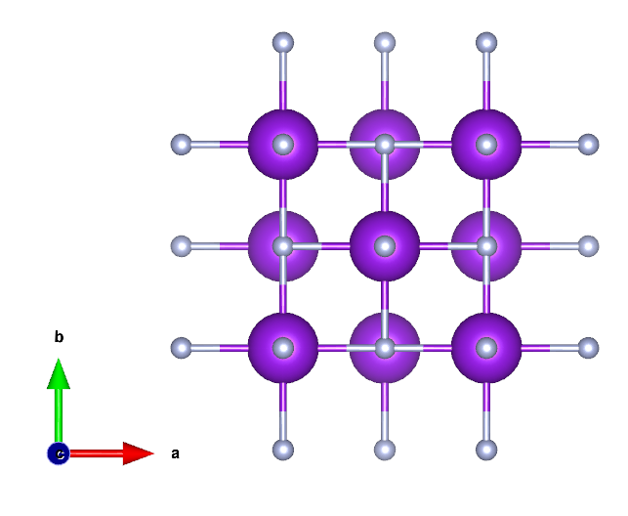
Si terminated SiC and KF
Si terminated SiC
KF
2.65441(0) Å
1.89718(0) Å
E_KF = -33.71625658/4 = -8.42906
E_SiC_Si =
-635.86651487

Slide 3
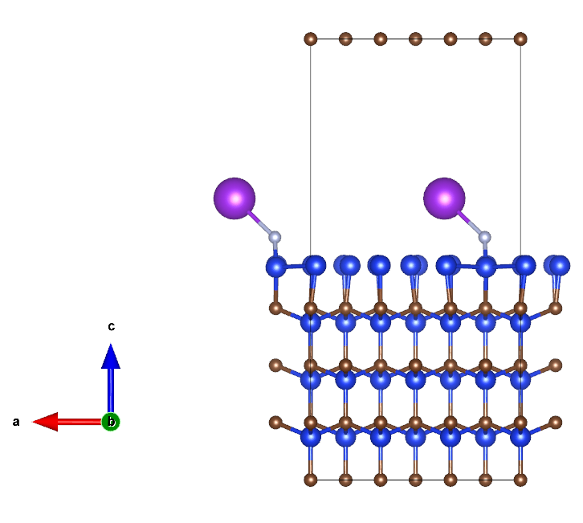
DFT calculation on adsorption of KF on Si layer on SiC
After adsorption of KF
Adsorption energy:
Ead = Etot - E_SiC_Si - E_KF = -1.05898
1.64059(0) Å
1.98647(0) Å
Etot = -645.35468814

Slide 4
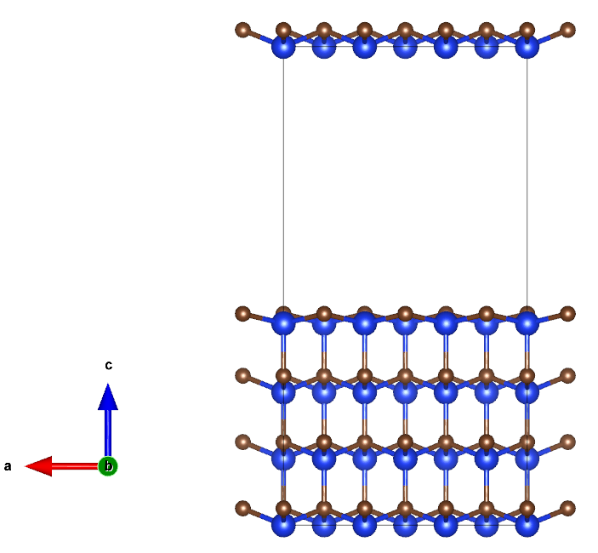
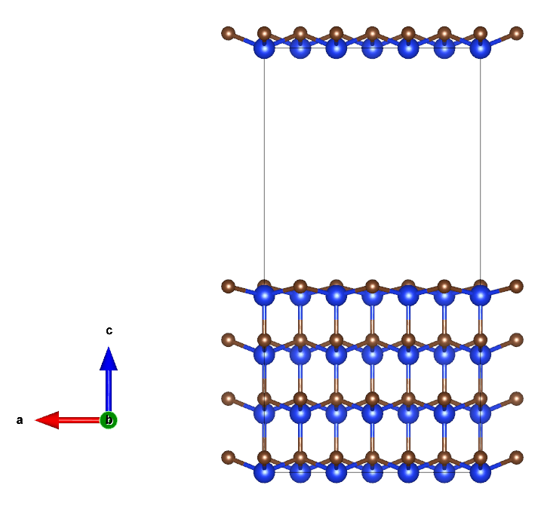
DFT calculation on adsorption of KF on C layer on SiC
C terminated SiC
C terminated SiC
KF
2.65441(0) Å
With fixing the nearest Si layer
Without fixing the nearest Si layer
1.90327(0) Å
1.98716(0) Å
E_SiC_C = -675.693
E_KF = -33.71625658/4 = -8.42906

Slide 5
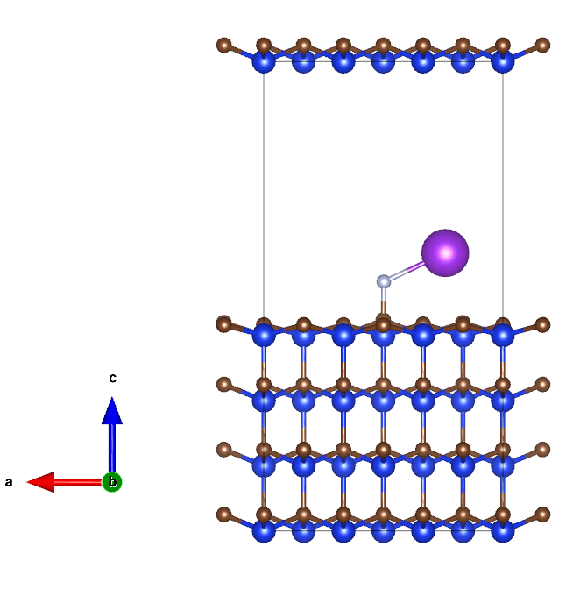
DFT calculation on adsorption of KF on C layer on SiC
After adsorption of KF
Adsorption energy:
Ead = Etot - E_SiC_Si - E_KF = -0.30545
1.49067(0) Å
-1.05898
Etot = -684.427
Si-F prefers to be formed than C-F

Slide 6
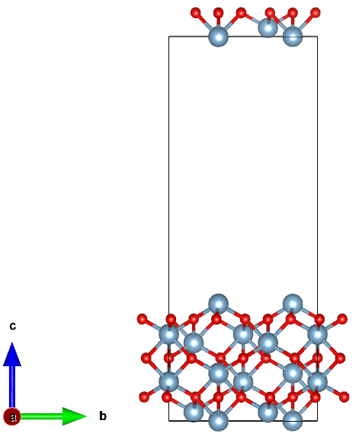
Al terminated Al2O3 and KF
Al terminated Al2O3
KF
2.65441(0) Å
E_KF = -33.71625658/4 = -8.42906
E_Al2O3_Al = -442.854

Slide 7
Al terminated Al2O3 and KF
Adsorption energy:
Ead = Etot - E_Al2O3_Al - E_KF = -0.90743
F-Al
K-O
E_tot = -452.191

Slide 8
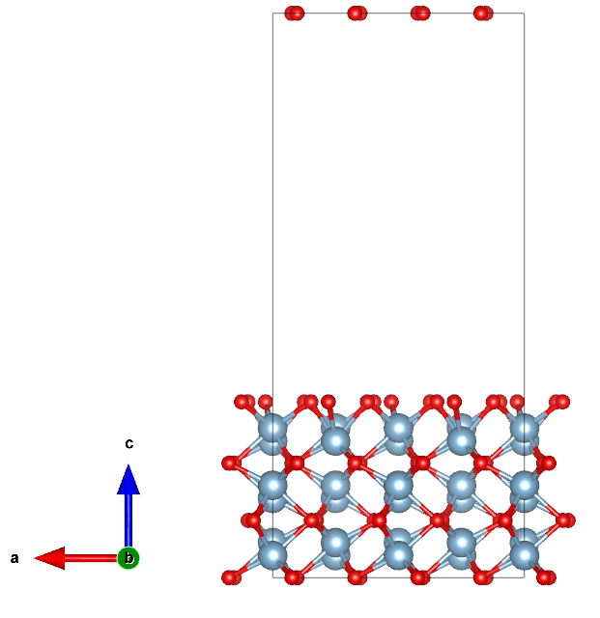
O terminated Al2O3 and KF
O terminated Al2O3
KF
2.65441(0) Å
E_KF = -33.71625658/4 = -8.42906
E_Al2O3_O = -463.578

Slide 9
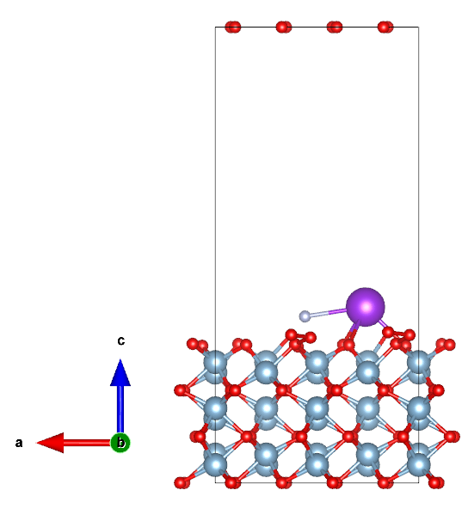
O terminated Al2O3 and KF
Adsorption energy:
Ead = Etot - E_Al2O3_Al - E_KF = -6.32389
K-O
E_tot = -478.331

Slide 10
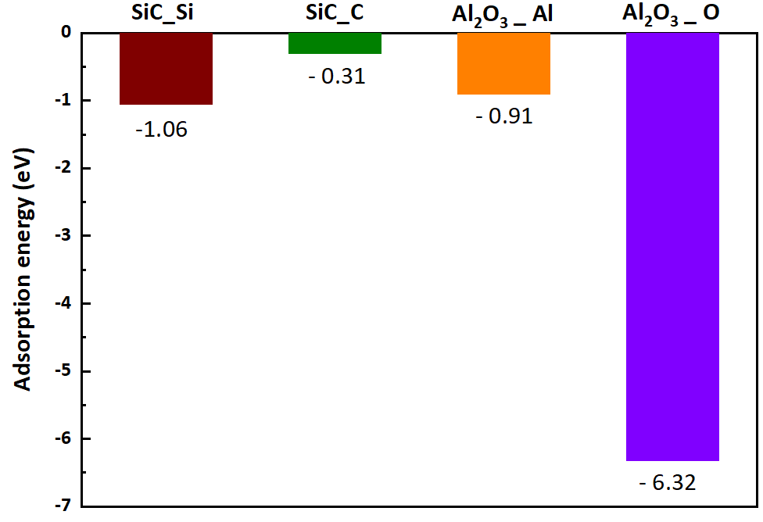
Adsorption energy of KF – SiC and KF – Al2O3
O – K, Si - F, Al - F

Slide 11
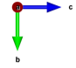
Electron configurations between Si-F
K
F
Si
Covalent Bond
F
Ionic bonding
Si

Slide 12
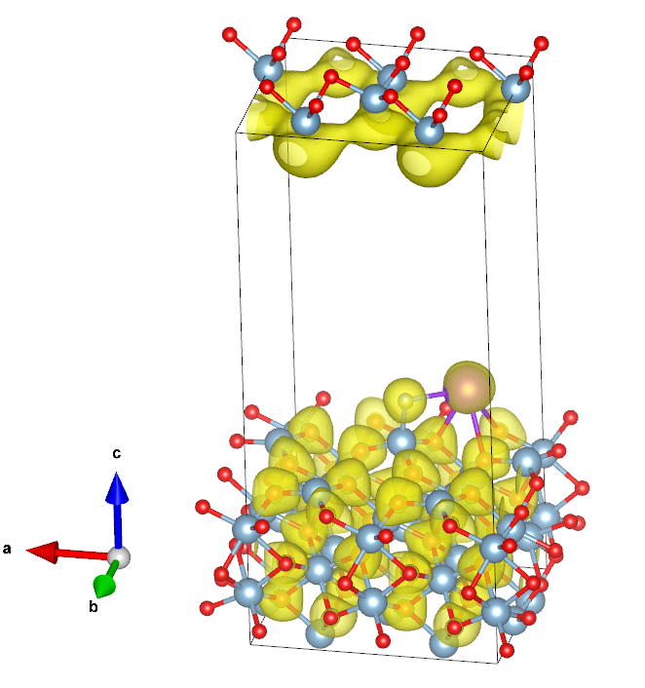
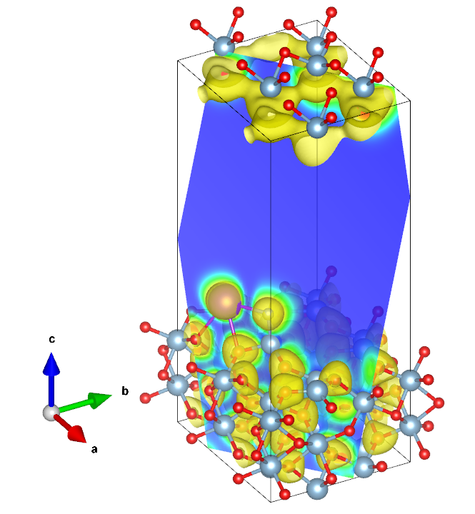
Electron configurations between K-O and F-Al
Al-F
K-O
All ionic bond

Slide 13
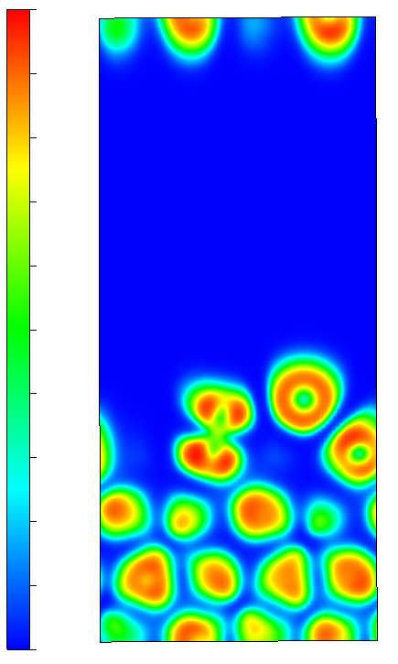
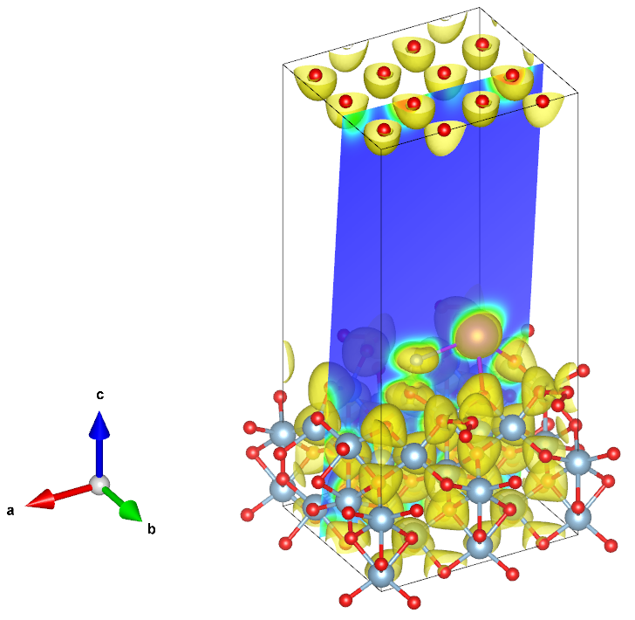
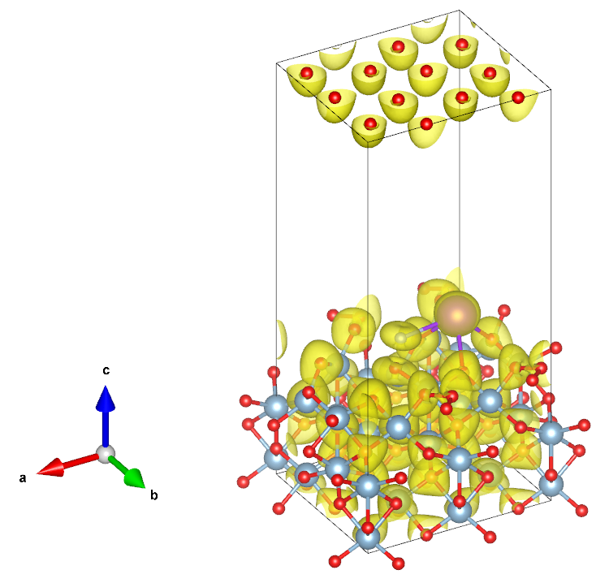
Electron configurations between K-O
K
K-O
F
O

Slide 14
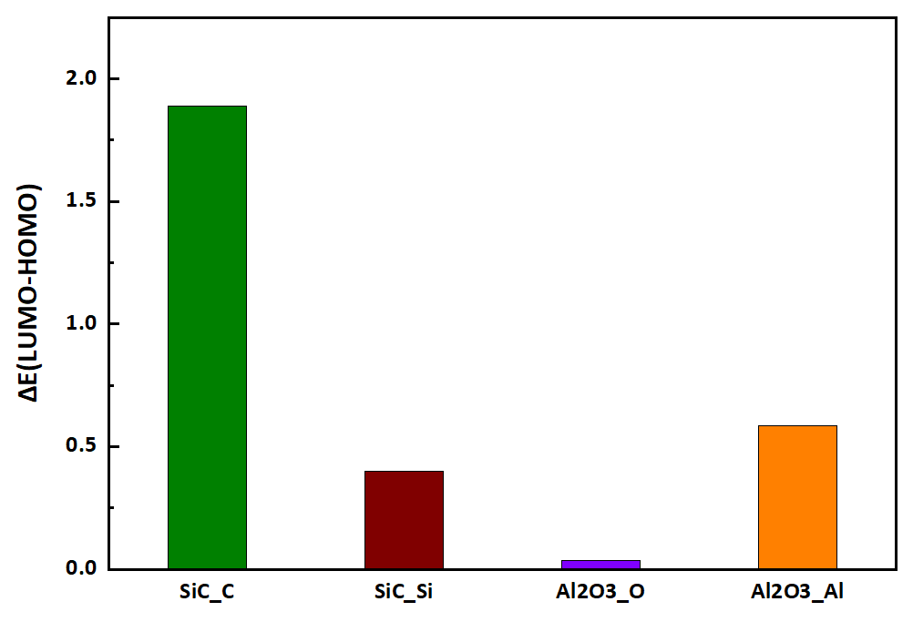
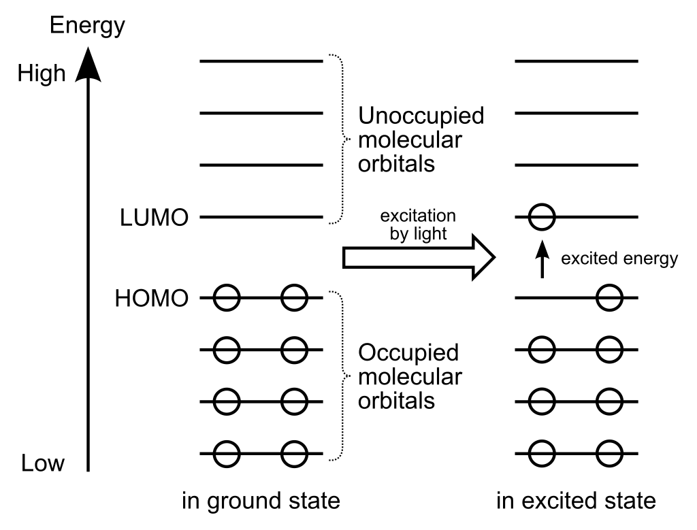
HOMO-LUMO

